Slide 1
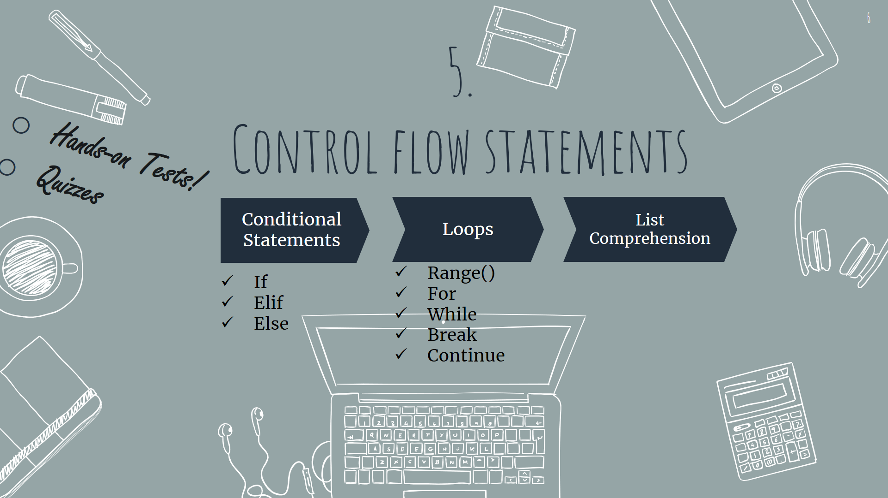

Slide 2
Previously on the course…
We learnt how to make different data structures and variables in python:
int , float , str , bool
list, dictionary, set , tuple
We learnt how to calculate and operate different operations between variables:
X + Y , X * Y , X // Y …
X in Y , X is Z
…

Slide 3
And now…
But how can we change control flow?
1. How to run only a specific parts of the code? → Conditional Statements
2. How to run some parts of the code more than once? → Loops

Slide 4
Contents
Conditional Statements
1
Loops
2
List Comprehension
3
if … elif … else
while… for
A way to make lists quickly

Slide 5
Conditional Statements
Sometimes we just want to execute certain parts of the code,
For example
if my salary < expenses → Send a warning for me.
If my salary >= equal to my expenses → Print “You’re fine!”
Three important key words:
if
elif
else

Slide 6
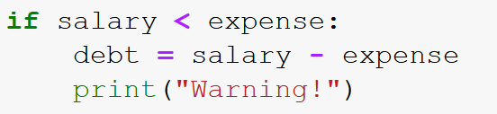
if Syntax
The key word to start conditional statements
Always this notation comes after each conditional statement
if some_condition :
#some_code
#some_code
A simple example…
Indentation is really important for all statements inside the conditional scope

Slide 7
if-else Syntax
if some_condition:
#some_code
#some_code
If and else notations are lined up with each other
else :
#some_code
#some_code

Slide 8
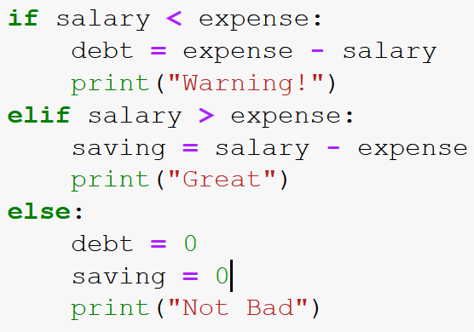
if-elif-else Syntax
if some_condition:
#some_code
#some_code
A simple example…
If and else and elif notations are all lined up with each other again
elif some_other_condition :
#some_code
#some_code
You can have as many elif statements as you want!
else :
#some_code
#some_code

Slide 9
Now let’s get back to the code…

Slide 10
Contents
Conditional Statements
1
Loops
2
List Comprehension
3
if … elif … else
while… for
A way to make lists quickly

Slide 11
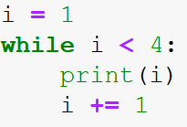
While loops
With while loops in python, we can execute a set of lines of code as long as the condition is true:
Always this notation comes after each conditional statement
This notation is used to start a while-loop.
while some_condition :
#some_code
#some_code
A simple example…
Indentation is really important, it separates all the statements inside and outside the loop
>> 1
>> 2
>> 3

Slide 12
While loops
With while loops → You can execute a set of commands as many times as you want.
break – continue - pass
Be careful about using while loops!
You need to make sure that at some point, the condition in while loop will be True! Otherwise your program keeps running with no ending.
These errors are called run-time errors.

Slide 13
Now let’s see some examples using ‘while’ in code…

Slide 14
For loops - Iteration
Some objects in Python are iterable ,
it’s possible to iterate in every element of the object
Mylist = [“hey” , 1 , 2 , 3]
#Some Iteration Code →
For iteration in python we use for loops
>> hey
>> 1
>> 2
>> 3

Slide 15
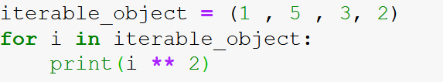


For loops - Iteration
Don’t forget to use “:” here too!
This notation is used for for-loops
for i in iterable object :
#some_code
#some_code
A simple example…
Indentation is really important, it separates all the statements inside and outside the loop

Slide 16
Now let’s see the iteration concept in code…

Slide 17


For loops – range() function
The range() function returns a sequence of numbers.
We can use range() function to make another type of loops.
Start: $Starting index (default=0)$
range(Start , Stop , Step)
Stop: $Ending index −1$
Step: $Size of every jump (default=1)$

Slide 18
For loops – range() function
“in” operator is used here again.
Here’s an example:
Let’s return to the code for more examples…
for i in range(0 , 5 , 1) :
print(i)
Don’t forget to use “:” here too!
>> 0
>> 1
>> 2
>> 3
>> 4

Slide 19
Contents
Conditional Statements
1
Loops
2
List Comprehension
3
if … elif … else
while… for
A way to make lists quickly

Slide 20
List Comprehension
List comprehension is one of the special ways of creating lists in python.
Other ways like using .append() method is also available.
But, list comprehension is easier and includes less lines of code.
Let’s see some examples…

Slide 21

Thanks!
Got any questions or suggestions?
Here’s some contact info:
@KMasoumi

